Slide 1
Business, Marketing, Entrepreneurship, Digital Marketing, and Econ Mrs. Schafer

Slide 2
Economics
Price Controls

Slide 3
Surplus
Consumer surplus is the difference between the maximum price a consumer is willing to pay and the price actually paid.
Producer surplus is the difference between the minimum price a producer is willing to accept and the price actually received.
An outcome is efficient when an allocation of resources maximizes total surplus.

Slide 4
Deadweight Loss
The loss of total economic efficiency—consumer and producer surplus—that occurs when the freely competitive market equilibrium is not achieved, resulting in reduced trade. It represents lost gains from trades that do not happen, often caused by market distortions like taxes, subsidies, price ceilings (e.g., rent control), price floors (e.g., minimum wage), or monopoly pricing.
Taxing specific goods leads to a deadweight loss, which reflects reduced economic activity.
Taxing goods with an inelastic demand (price doesn’t affect as much) (and/or supply) leads to a smaller deadweight loss.

Slide 5
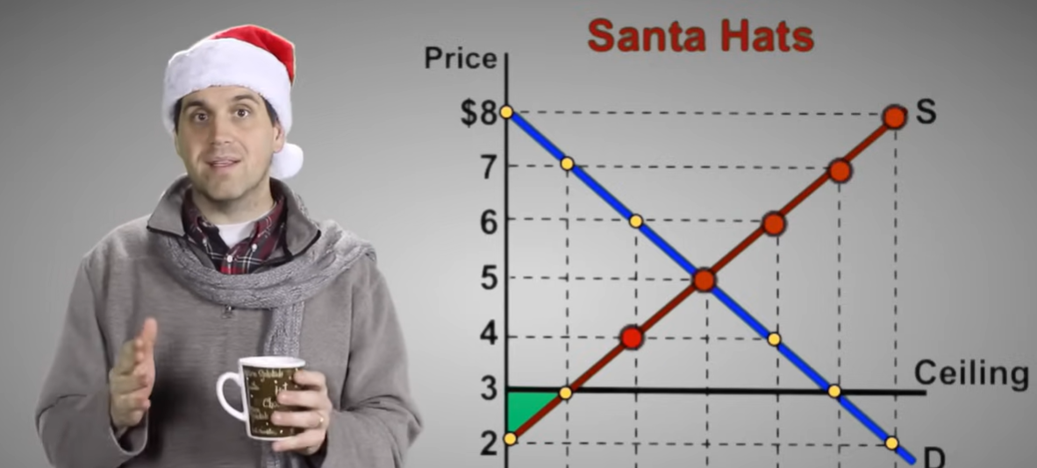
Deadweight Loss Video Consumer and Producer Surplus- Micro Topic 2.6 (Holiday Edition)
Notes:
Consumer and Producer Surplus- Micro Topic 2.6 (Holiday Edition)

Slide 6
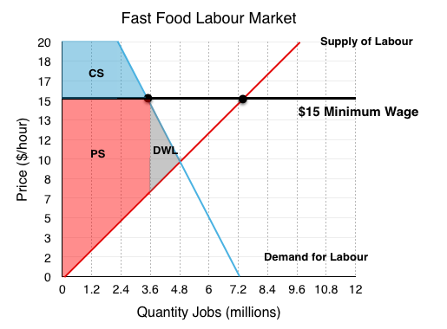
Deadweight Loss
All of the lost surplus that could have been there had it not been for the unnatural new pricing

Slide 7
Big Questions That Will be Answered in This Lesson
When do price ceilings matter?
What effects do price ceilings have on economic activity?
When do price floors matter?
What effects do price floors have on economic activity?
Notes:
Lecture notes:
You can introduce the “Big Questions” by mentioning the following points to students:
Price ceilings are legally established maximum prices for goods or services.
Price floors are legally established minimum prices for goods or services.
Although ceilings and/or floors might have good intentions, it is important to think about unintended consequences.

Slide 8
Price Controls
Price Ceiling
Legally set maximum price
Rent controlled apartments, price gouging laws
Imposed when market prices is “too high”
Intended to help consumers
Price Floor
Legally set minimum price
Minimum wage
Imposed when market price (in minimum wage it’s the market for labor) is “too low”
Intended to help producers
Notes:
Lecture tip:
Imposes ceilings when the market price is “too high.”
Intended to help consumers.
Imposes floors when the market price is “too low.”
Intended to help producers.

Slide 9
When Do Price Ceilings Matter?
Let’s start with a simple thought experiment.
The government imposes a price ceiling on bread of $0.50 per loaf.
What are some unintended consequences?
Notes:
Lecture notes:
Prices are rising, so the government wants to help low-income households.

Slide 10

$0.50 Price Ceiling on Bread
Question | Explanation | In pictures
Will there be more or less bread for sale? | Consumers want to purchase more, but producers will manufacture less. Shortage! | Empty shelves
Will the size of a typical loaf change? | Manufacturers will try to maintain profits by reducing the size of each loaf. | No more giant loaves
Will the quality change? | Expensive brands will no longer be profitable to produce. | Focaccia bread would disappear
Will the opportunity cost of finding bread change? | Opportunity cost of finding bread will rise. Resources spent looking for bread in different stores and waiting in line. | Bread lines would become the norm
Would you buy illegal bread if you could? | Since bread is hard to find, and people still need it, an illegal market will develop. | Illegal bread dealers reduce the shortage
Notes:
Lecture tip:
Click through to reveal the table one row at a time.
First click: More or less bread for sale?
Lower price increases quantity demand, decreases quantity supplied, so get a shortage.
Second click: Size of loaf
Gets smaller so that the firm can maintain some profits.
Third click: Quality
Goes down as firms use cheaper ingredients.
Fourth click: Opportunity cost
The opportunity cost will be higher.
Note that once you include the OC of waiting in line, the full cost to the consumer will be more than the market price.
Fifth click: Illegal bread
Illegal markets may form.

Slide 11

The Effects of Price Ceilings
Three different situations:
A nonbinding price ceiling
A binding price ceiling
Long-run effects of price ceiling
Notes:
Lecture tip:
The graphs on the next three slides will exemplify each of the situations.
[ESB Professional/Shutterstock]

Slide 12
1. Nonbinding Price Ceiling
Notes:
Image: Animated Figure 6.1
Lecture notes:
Without the price ceiling, P_{E} = $1 and Q_{E} is the equilibrium quantity.
First click:
Government imposes a $2.00 price ceiling.
Second click:
Shades in area below $2.00: Any price = < $2.00 is legal.
Third click:
Shades in area above $2.00: Any price > $2.00 illegal.
Since E occurs in the green area, the price ceiling does not influence the market; it is nonbinding.

Slide 13
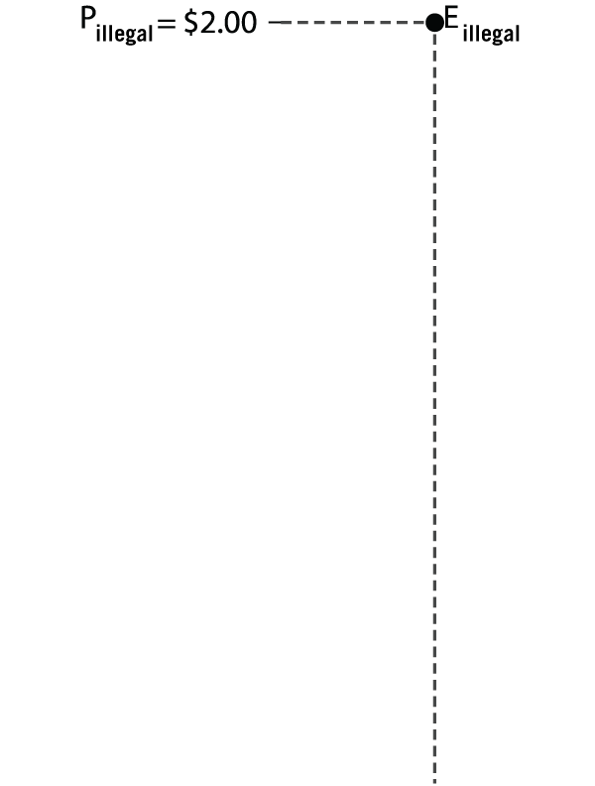
2. Binding Price Ceiling
Notes:
Image: Animated Figure 6.2
Lecture notes:
This figure looks at the effect of a binding price ceiling in the short run.
Without the price ceiling, P_{E} = $1 and Q_{E} is the equilibrium quantity.
First click:
Government imposes a $0.50 price ceiling.
Second click:
Shades in area below and above price ceiling.
Since E occurs in the red area, the price ceiling does influence the market; it is binding.
Third click:
Labels Q_{S} and Q_{D} and Shortage
At the price ceiling of $0.50, Q_{D} > Q_{S}, so there is a shortage of bread.
Note that this is a general consequence of a binding price ceiling (to get shortages).
At this point, you could discuss alternative rationing methods when there are shortages (such as waiting in line, ration coupons based on need, etc.).
Point out that in an uncontrolled market, price rations the good (i.e., if there was excess demand, price would increase to bring the market back to E).
Fourth click:
Labels illegal market price.
With only Q_{S} units available, consumers are willing and able to pay $2.00 per loaf.
This eliminates the shortage, but the price is well above the price ceiling.
You can go beyond the example above by proposing the following situation:
Suppose there were no illegal market, and the Q_{S} units of bread were allocated by consumers waiting in line.
What does the difference between the $2.00 and the ceiling price of $0.50 represent?

Slide 14
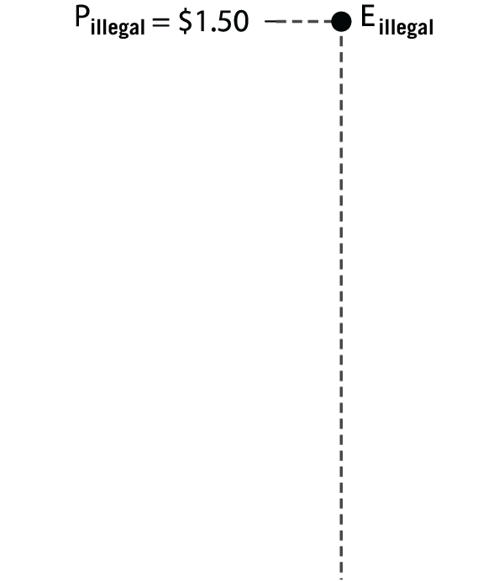
3. Price Ceilings in the Long Run
Notes:
Image: Animated Figure 6.3
Lecture notes:
The figure looks at the effect of a binding price ceiling in the long run.
Without the price ceiling, P_{E} = $1 and Q_{E} is the equilibrium quantity.
Since we are considering the long run, note that the demand and supply curves are more elastic. Ask students why they think that is.
Supply: Bakers respond in the long run by producing less bread and making products that are not subject to price controls.
Demand: In the long run, consumers will attempt to take advantage of the price ceiling by changing eating habits to consume more bread.
First click:
Labels price ceiling and shaded areas.
Second click:
Labels new Q_{S} and Q_{D} and new shortage.
So in the long run, the shortage gets larger.
Third click:
Adds illegal market price.
Long-run illegal market prices are less than before ($2.00).
Consumers have had time to find alternatives.

Slide 15
Practice What You Know—1
What will be the effect of a nonbinding price ceiling?
A surplus will be created.
A shortage will be created.
There will be no effect.
The effect is unknown.
Notes:
Clicker question:
Correct answer: C, There will be no effect.
If the price ceiling is nonbinding (above the equilibrium), the equilibrium price is already in the legal range, so nothing will change.

Slide 16
Practice What You Know—1
What will be the effect of a nonbinding price ceiling?
A surplus will be created.
A shortage will be created.
There will be no effect.
The effect is unknown.
Notes:
Clicker question:
Correct answer: C, There will be no effect.
If the price ceiling is nonbinding (above the equilibrium), the equilibrium price is already in the legal range, so nothing will change.

Slide 17
Practice What You Know—2
In the event of a binding price ceiling, what is one function that an illegal market serves?
It reduces the shortage caused by the price ceiling.
It decreases the price even further.
It creates a monopoly.
It causes a surplus of the good.
Notes:
Clicker question:
Correct answer: A, It reduces the shortage caused by the price ceiling.
More trading may illegally take place at higher prices with an illegal market.

Slide 18
Practice What You Know—2
In the event of a binding price ceiling, what is one function that an illegal market serves?
It reduces the shortage caused by the price ceiling.
It decreases the price even further.
It creates a monopoly.
It causes a surplus of the good.
Notes:
Clicker question:
Correct answer: A, It reduces the shortage caused by the price ceiling.
More trading may illegally take place at higher prices with an illegal market.

Slide 19
Practice What You Know—3
Supply and demand generally become more elastic in the long run. This means that shortages caused by price ceilings _________________ in the long run.
disappear completely
become smaller
become larger
become infinitely large
Notes:
Clicker question:
Correct answer: C, become larger.
Q_{D} and Q_{S} will be more responsive to price changes when demand and supply are more elastic. Thus, shortages are made worse because Q_{D} rises faster and Q_{S} falls faster.

Slide 20
Practice What You Know—3
Supply and demand generally become more elastic in the long run. This means that shortages caused by price ceilings _________________ in the long run.
disappear completely
become smaller
become larger
become infinitely large
Notes:
Clicker question:
Correct answer: C, become larger.
Q_{D} and Q_{S} will be more responsive to price changes when demand and supply are more elastic. Thus, shortages are made worse because Q_{D} rises faster and Q_{S} falls faster.

Slide 21
What Effects Do Price Ceilings Have on Economic Activity?
Two real-world examples:
Rent control
Price gouging laws
Notes:
Lecture notes:
Rent control:
Price ceiling that applies to the market for apartment rentals
Price gouging laws:
Temporary ceiling on the prices that sellers can charge during times of emergency

Slide 22
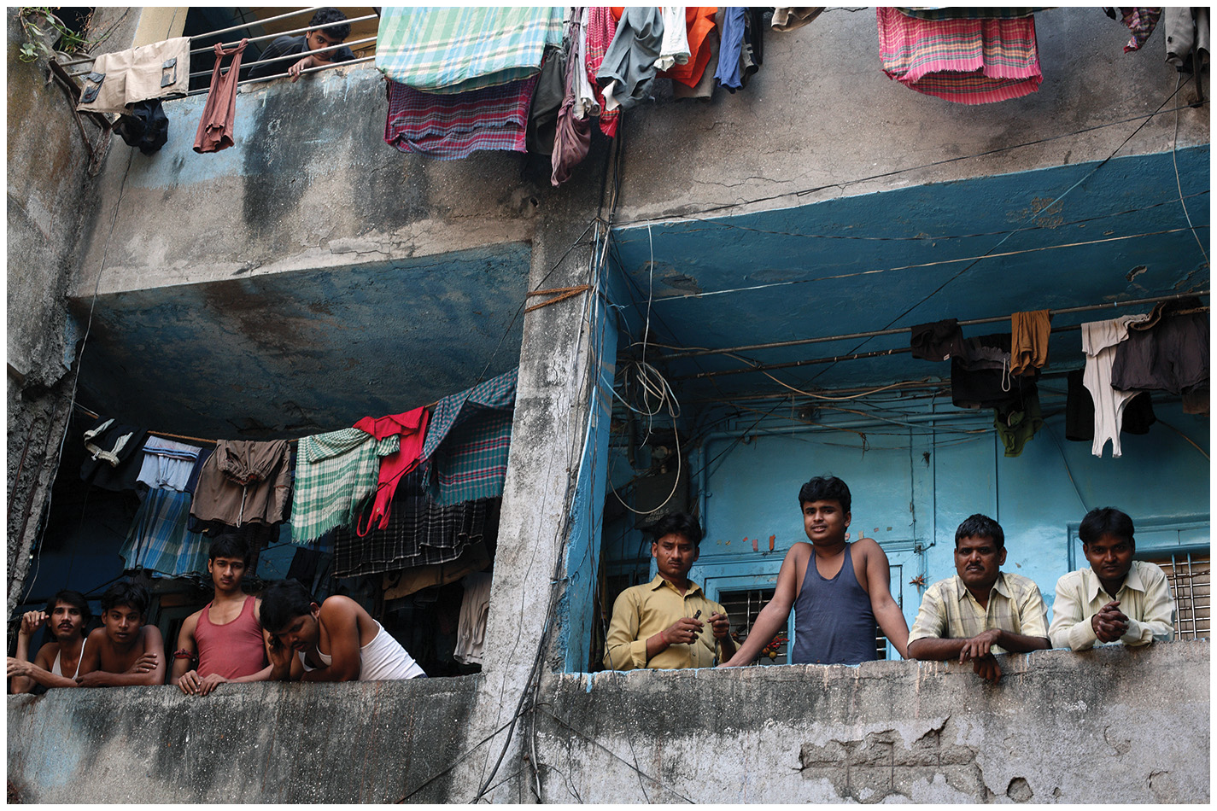
Rent Control—1
Besides shortages, what are some unintended consequences of rent controls?
Reduction in quality of apartments:
Either less maintenance or decay
Notes:
Lecture notes:
Shortage, since Q_{D} > Q_{S}.
Since the rent control is so low, owners have less revenue for maintenance.
To make a reasonable profit, rent control policies have led to the decay of many apartment buildings.
The image on the slide is a picture of apartment building in Mumbai, India.
[Alex Craig/Getty Images]

Slide 23
Rent Control—2
What are some other unintended consequences of rent controls?
Landlords “nickel and dime” tenants with fees to increase revenues.
Long-term investment in the building of new units decreases.
The policy often ends up hurting the very people it was supposed to help.
Notes:
Lecture notes:
Although the law limits the rent that landlords may charge, landlords can charge “add-on fees,” key fees, and high security deposits.
If there are rent controls, there is less incentive to invest in building a new unit, which makes the shortage worse in the long run.
Other consequences can include:
It provides an incentive for people to stay in rent-controlled housing longer than they would have otherwise.
Rent-controlled apartments are passed from one generation to the next in order to remain in the program, so many people who live in rent-controlled apartments are no longer low income.
Owners of rent controlled buildings may convert them to other uses (i.e., turn them into condos).

Slide 24
Practice What You Know—4
What is one unintended consequence of rent control?
People in rent-controlled units will relocate more often.
Landlords may not maintain rental units.
Too many apartments will be built, creating a surplus of units.
People will choose not to live in big cities.
Notes:
Clicker question:
Correct answer: B, Landlords may not maintain rental units.
With artificially low prices, the landlords may decide it is not worth the time or effort to keep units clean and fixed.

Slide 25
Practice What You Know—3
Supply and demand generally become more elastic in the long run. This means that shortages caused by price ceilings _________________ in the long run.
disappear completely
become smaller
become larger
become infinitely large
Notes:
Clicker question:
Correct answer: C, become larger.
Q_{D} and Q_{S} will be more responsive to price changes when demand and supply are more elastic. Thus, shortages are made worse because Q_{D} rises faster and Q_{S} falls faster.

Slide 26
Practice What You Know—3
Supply and demand generally become more elastic in the long run. This means that shortages caused by price ceilings _________________ in the long run.
disappear completely
become smaller
become larger
become infinitely large
Notes:
Clicker question:
Correct answer: C, become larger.
Q_{D} and Q_{S} will be more responsive to price changes when demand and supply are more elastic. Thus, shortages are made worse because Q_{D} rises faster and Q_{S} falls faster.

Slide 27

Price Gouging—1
Price gouging laws:
Temporary price ceilings imposed during emergencies
Imagine that there’s a disease pandemic caused by a new virus. How would an uncontrolled market deal with an increase in the demand for hand sanitizer?
Notes:
Lecture notes:
Make sure students don’t confuse “price gouging” with paying prices that consumers think are “too high.”
$10 for a soda at a movie? We often willingly purchase goods, even if we think they are too expensive.
To complete the scenario outlined on the slide:
Because of the hurricane, the demand for generators increases.
At the initial price, there would be an excess demand for generators.
Remember that prices act to ration scarce resources.
So, with excess demand, the price of a generator increases.
This ensures that the available units are distributed to those who value them the most.
The higher price also provides suppliers with an incentive to provide more generators.
This is how markets are supposed to work.
[Maridav/Alamy Stock Photo]

Slide 28
Conclusion
Prices act as signals and give information to consumers and producers.
Price controls can distort the signals.
Price controls lead to unintended consequences.
Notes:
Lecture notes:
One of the main roles of prices is that they signal the relative scarcity of different goods.
They also provide consumers and producers information on how to act.
Price controls lead consumers and producers to act in ways that they would not have done without the control.
Make sure to review some unintended consequences.
You can summarize the lecture on this chapter by reiterating the following points:
A price ceiling is a legally imposed maximum price.
The direct consequence is a shortage.
But there are also unintended consequences.
A price floor is a legally imposed minimum price.
The direct consequence is a surplus.
As with ceilings, there are also unintended consequences.
Lastly, as a final thought, you can discuss this F. A. Hayek quote: “The curious task of economics is to demonstrate to men how little they really know about what they imagine they can design.”

